Slide 1
The anticipated difficult airway;
how exposure and training in awake fibreoptic techniques are becoming increasingly difficult to attain in district general hospitals.
Presenter -Rhiannon Harling (CT3)
C0-author - Kate Brown (CT3)
Consultant – M.Bretland
Princess of Wales Hospital (Bridgend)

Slide 2
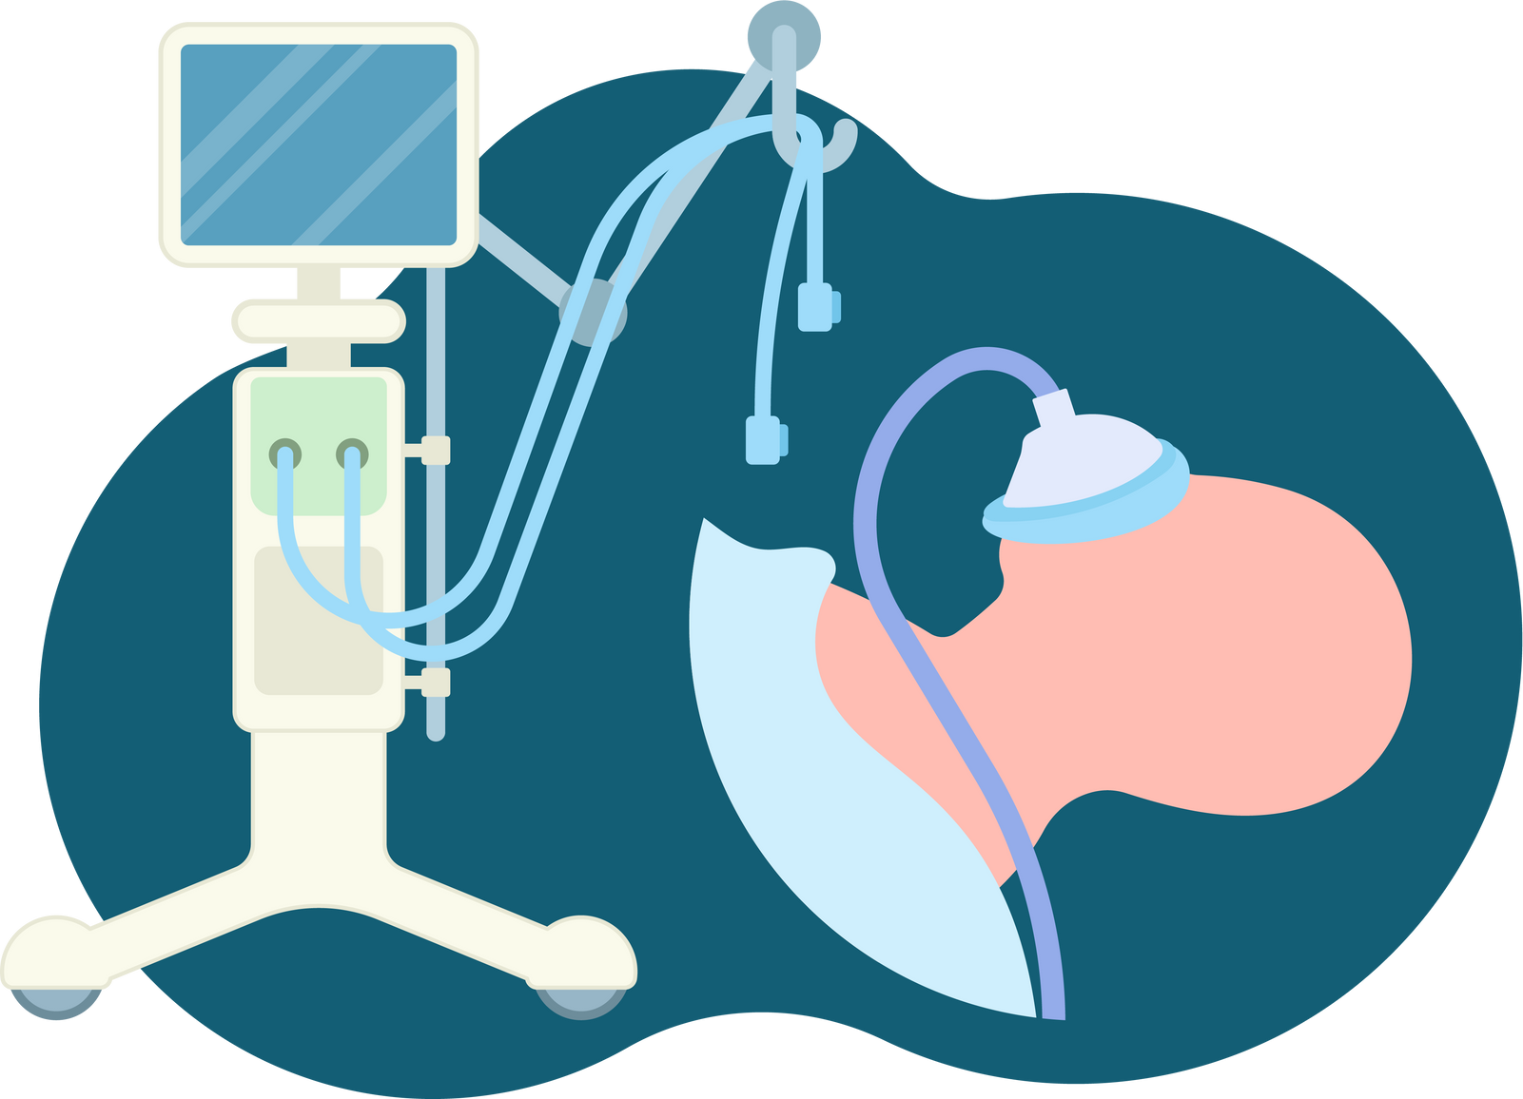
01.
Case review
02.
Awake intubation training survery
03.
Literature review and summary

Slide 3
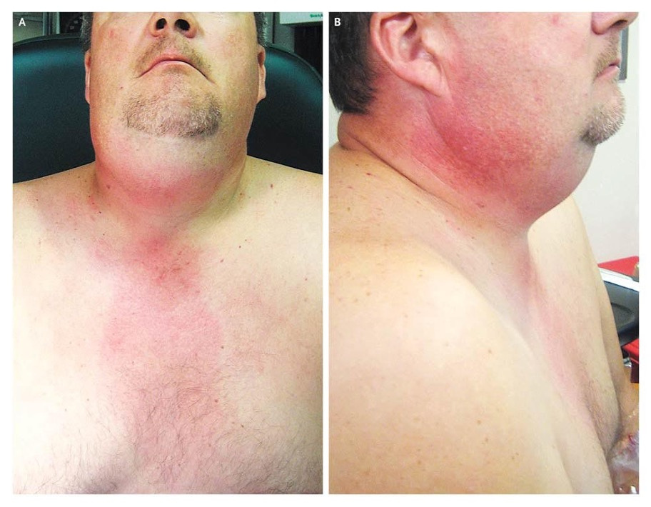
Case: A&E presentation at 2am
Male in 50s. Nil PMH
End of bed: Sat bolt up. intermittent stridor, unable to complete a sentence, excessive secretions, diffuse neck swelling
Airway assessment: Trismus, 2cm mouth opening
Nasal endoscopy: gross soft tissue swelling. Poorly identified anatomy
Ludwigs angina. N Engl J Med 2008; 359:1501

Slide 4
Case: Awake fibreoptic intubation
Initial plan:
Technique
Patient transfered to theatre
Airway plan: Nasal approach to awake fibreoptic
ENT scrubbed in theatre - site marked for emergency FONA
Oxygenate: THRIVE 70L 100%
Sedation: 1mg midazolam, remifentanil TCI CET 1ng/ml
Topicalise: Lidocaine 10% sprayed 6x sprays nostril, repeatd in oropharynx
Secretion management: 2x suction (yanker and catheter), glycopyroalte 200mcg
Procedure: undifferentiated soft tissue, secretions ++, size 6 reinforced tube.
Notes:
Add scope images
Details fo STOP intubation
- Patient taken to theatre. Plan with ENT and anaesthetic consultants. Scrubbed ENT - LA applied to around potential site of tracheotomy
Plan with ENT and anaesthetics – Awake fibreoptic intubation in theatre (nasal approach)
ENT consultant and SpR scrubbed in theatre
Sedation: Midazolam 1mg and remifentanil minto TCI ng/ml – CET 1
Other medication: Glycopyrolate 200mcg
THRIVE 70L 100%
Topicalization - 6 sprays 10mg/spray lidocaine in nostril and repeat 6 sprays in oropharynx
Some bleeding form nostril
Almost asphyxiated when spraying oropharynx so not repeated
Difficult anatomy ++ soft tissue undifferentiated
Copious secretions ++ yanker and suction catheter passed to clear and help views
Intubation start 06:25, propofol and rocuronium @ 06:40
CT 07:00…. ICU 07:40
ETCO2 9.0 when ET tube in pace (size 6) reinforced

Slide 5
Case: Awake fibreoptic intubation
Initial plan:
Technique
Patient transfered to theatre
Airway plan: Nasal approach to awake fibreoptic
ENT scrubbed in theatre - site marked for emergency FONA
Oxygenate: THRIVE 70L 100%
Sedation: 1mg midazolam, remifentanil TCI CET 1ng/ml
Topicalise: Lidocaine 10% sprayed 6x sprays nostril, repeatd in oropharynx
Secretion management: 2x suction (yanker and catheter), glycopyrolate 200mcg
Procedure: undifferentiated soft tissue, secretions ++, size 6 reinforced tube.
Notes:
Add scope images
Details fo STOP intubation
- Patient taken to theatre. Plan with ENT and anaesthetic consultants. Scrubbed ENT - LA applied to around potential site of tracheotomy
Plan with ENT and anaesthetics – Awake fibreoptic intubation in theatre (nasal approach)
ENT consultant and SpR scrubbed in theatre
Sedation: Midazolam 1mg and remifentanil minto TCI ng/ml – CET 1
Other medication: Glycopyrolate 200mcg
THRIVE 70L 100%
Topicalization - 6 sprays 10mg/spray lidocaine in nostril and repeat 6 sprays in oropharynx
Some bleeding form nostril
Almost asphyxiated when spraying oropharynx so not repeated
Difficult anatomy ++ soft tissue undifferentiated
Copious secretions ++ yanker and suction catheter passed to clear and help views
Intubation start 06:25, propofol and rocuronium @ 06:40
CT 07:00…. ICU 07:40
ETCO2 9.0 when ET tube in pace (size 6) reinforced

Slide 6
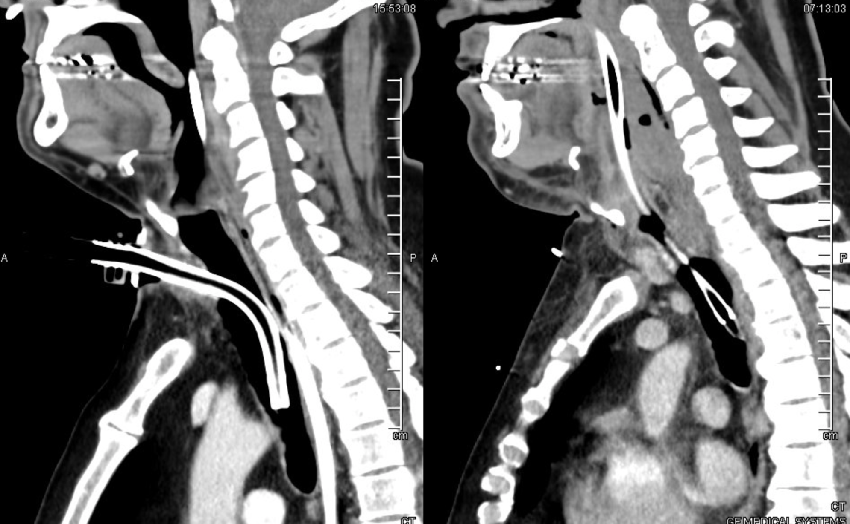

Slide 7
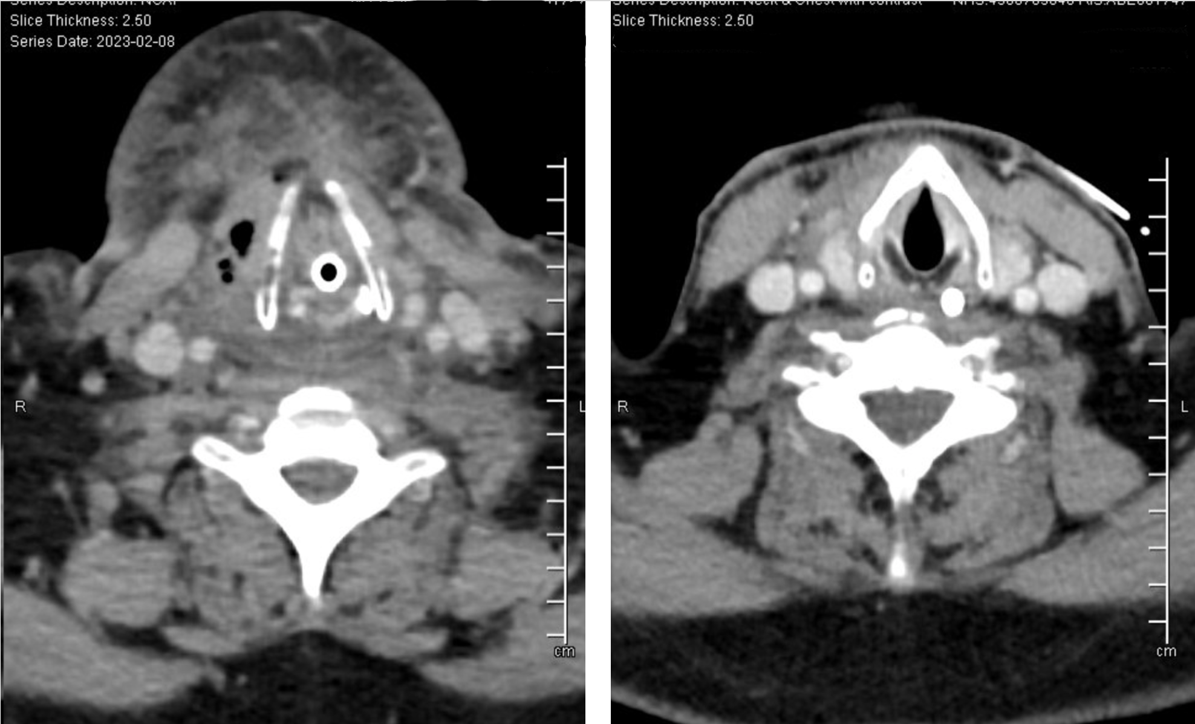

Slide 8
Conclusions and reflections
Patient discharged ICU 2 weeks later
As this case reflects, limited other options for airway management (truisms, diffuse swelling over tracheostomy site)
Presented CG with DAS guidelines 2019
Survey circulated to understand clinical exposure to ATI and training opportunities

Slide 9
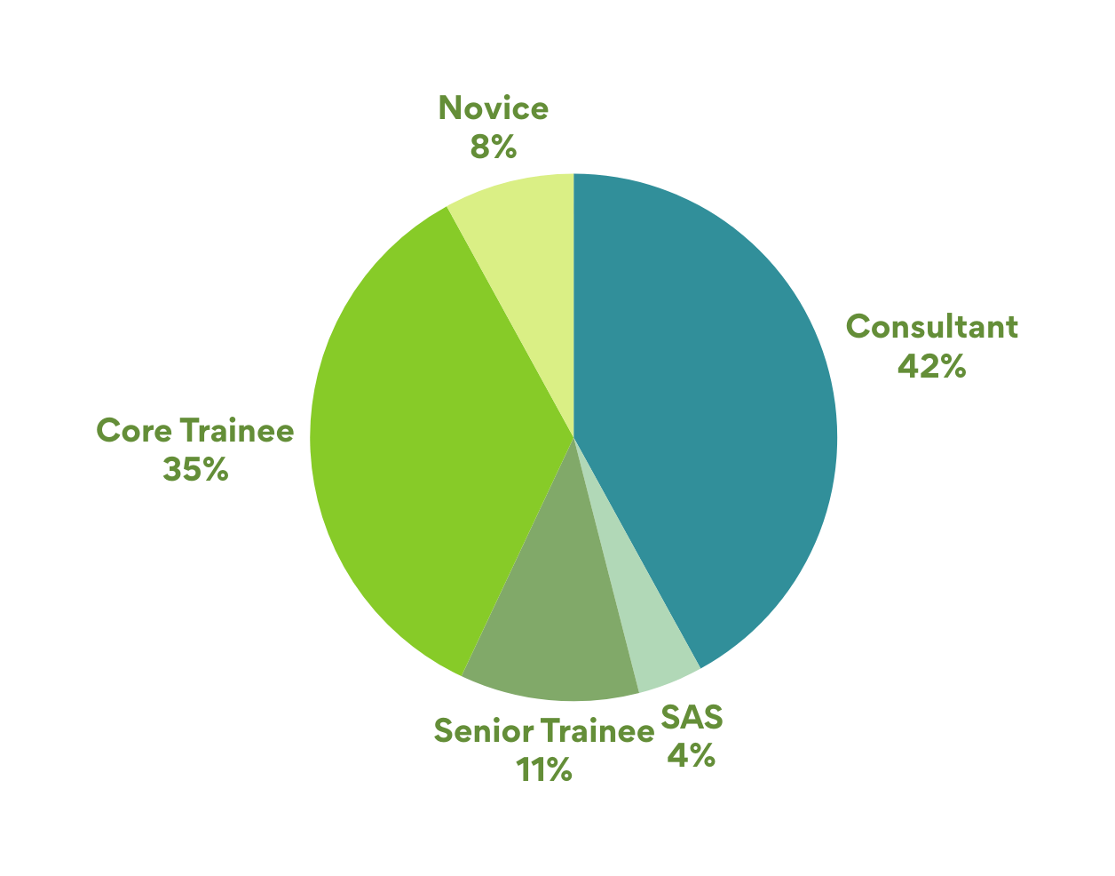
Survey results - 26 respondents

Slide 10
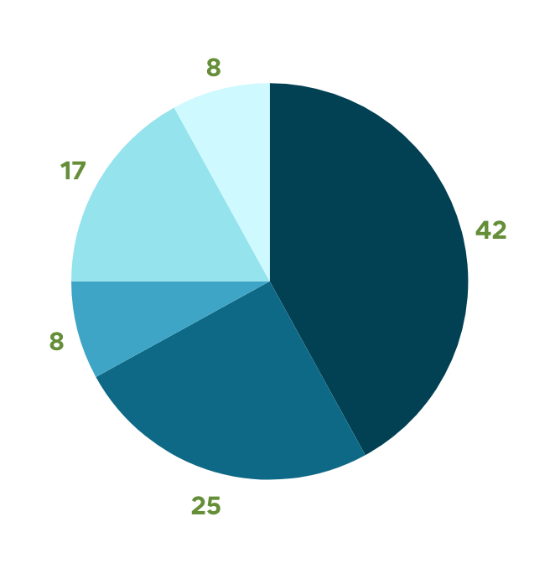
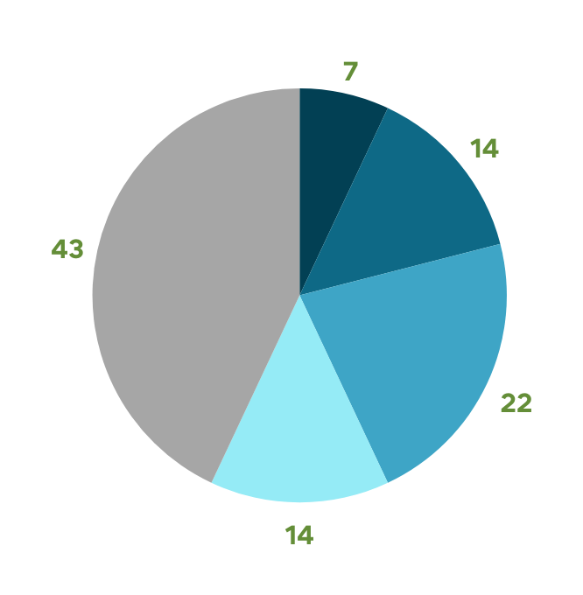
Last time performed an ATI
Senior anaesthetists:
Trainee anaesthetists:
> 2 years
1-2 years
6-12 months
2-6 months
2-8 weeks
< 2 weeks
Not performed

Slide 11
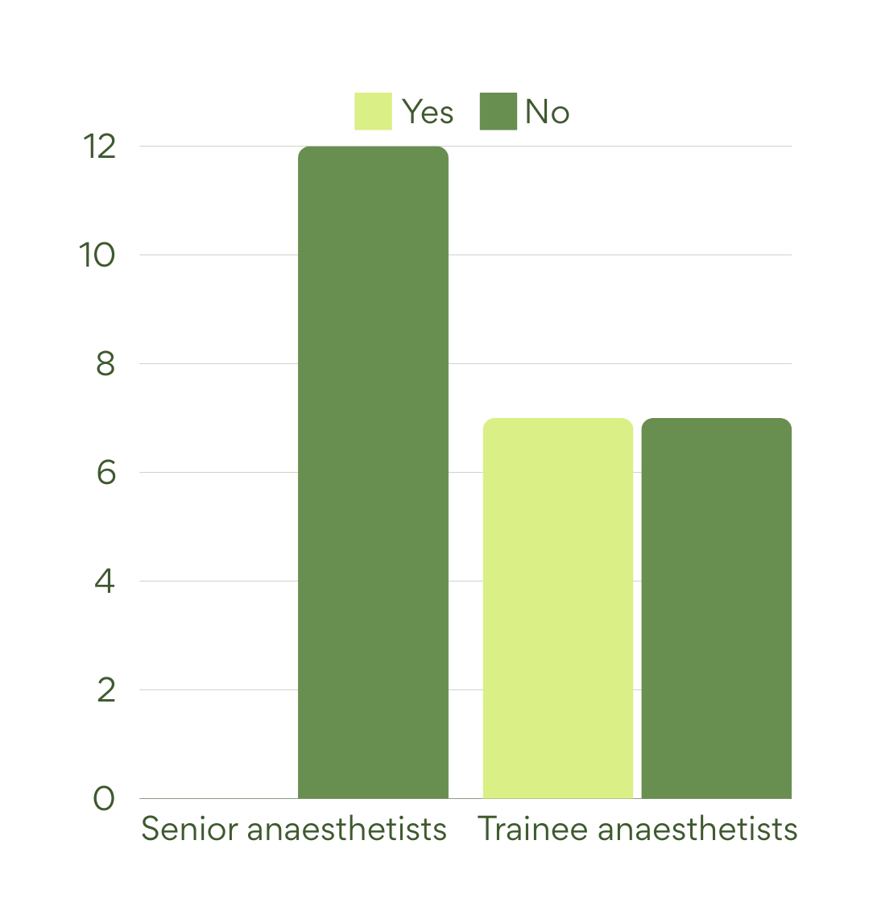
In the last 2 years,
have you had any
formal training
on ATI?

Slide 12
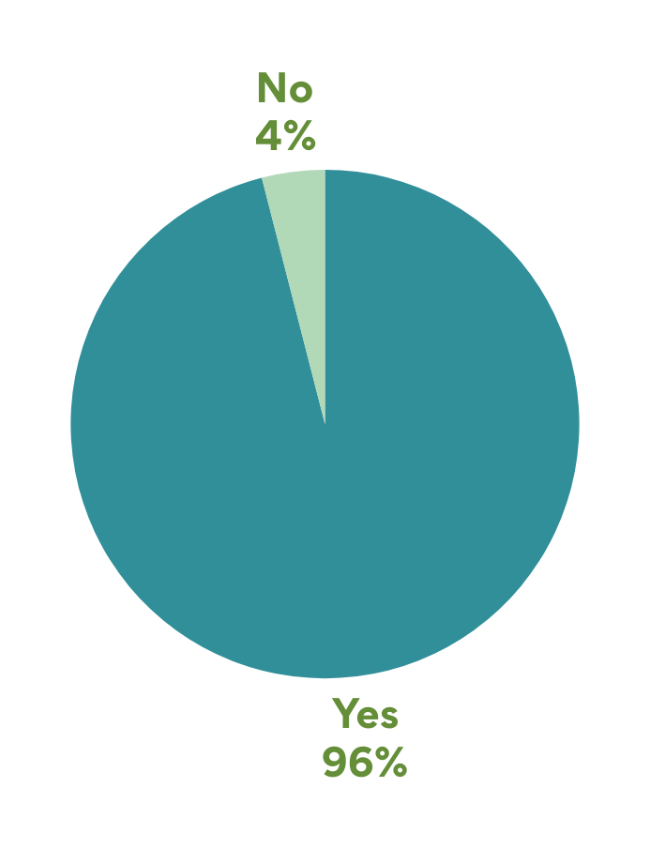
Do you think departmental teaching in ATI is beneficial?

Slide 13
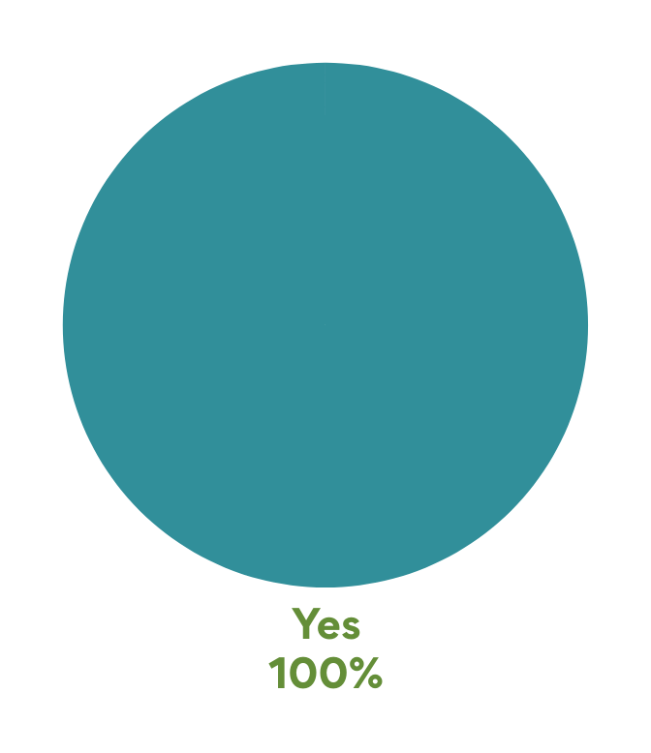
If yes, do you think this should be regular (every 1-2 years)?

Slide 14
Conclusions and reflections
Limited exposure to performing ATI for all anaesthetists
Trainees may have more opportunities as rotate to centres with complex ENT / head and neck procedures
Senior anaesthetists within DGH infrequent opportunities to clinical skill and training
Overwhelming response for need of regular ATI training

Slide 15
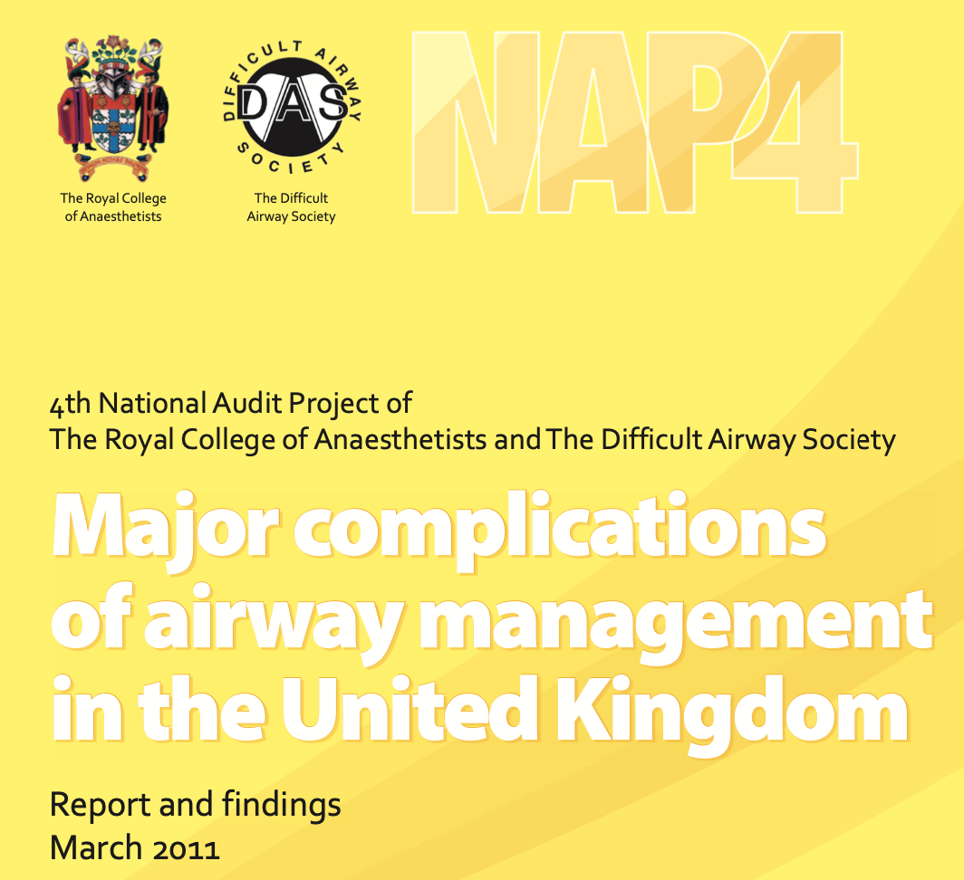

Slide 16
‘18 patients in whom AFOI might have offered advantages’
‘15 reports in which AFOI was unsuccessful’
‘Experience of the operator is of paramount importance, as inadequate local anaesthesia, or inappropriate sedation, can lead to failures’
‘Fibreoptic intubation is a procedure which requires familiarity with the equipment and an understanding of airway endoscopic anatomy’
‘The threshold for adopting AFOI depends to some extent on the competence and confidence of the person who will perform the intubation. it is likely some anaesthetists do not acquire the skills to perform the technique and it may be difficult for others to maintain them’

Slide 17
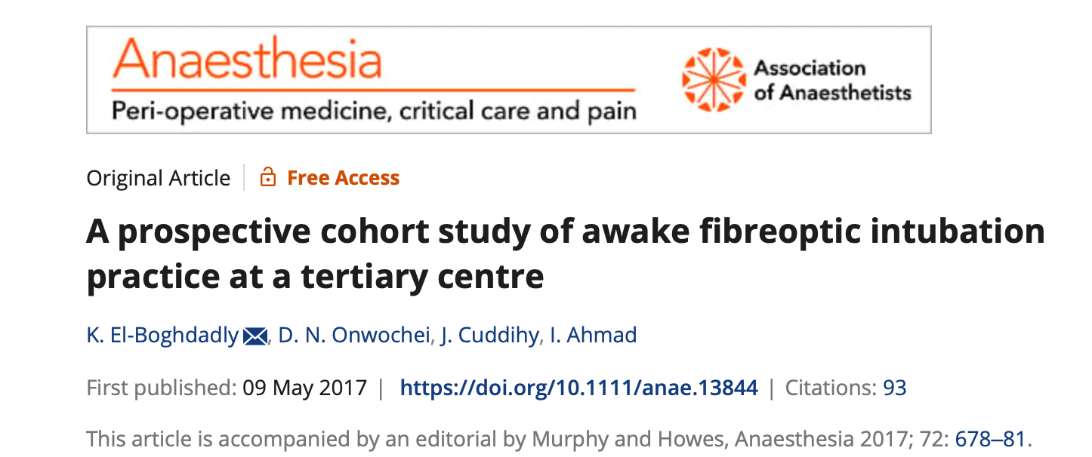
The only significant association with complications was the number of previous awake fibreoptic intubations performed, with fewer complications occurring in the hands of operators with more awake fibreoptic intubation experience.
Our data demonstrate that awake fibreoptic intubation is a safe procedure with a high success rate.

Slide 18
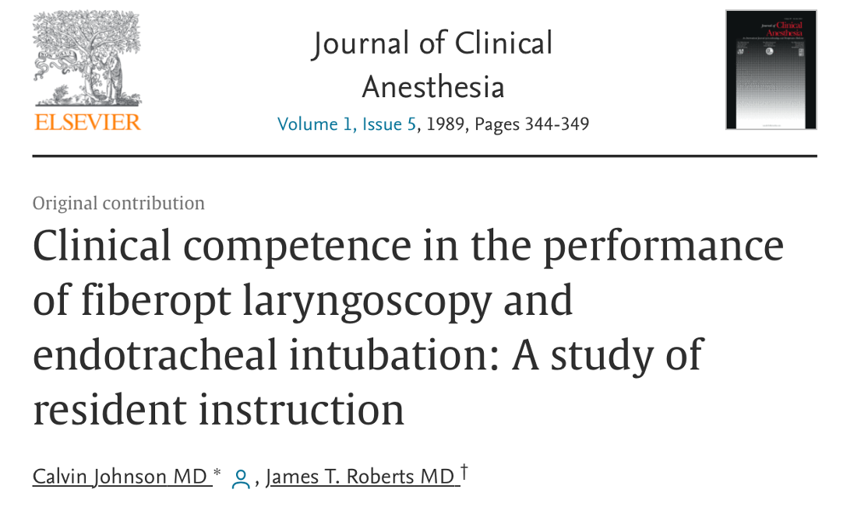
‘After the tenth intubation, the mean time was 1.53 minutes and the percent success on the first attempt at intubation was greater than 95%.’

Slide 19
This survery reflects what we already know - expsore to ATI is increasing limited partiuclarly inDGHs
Overwhelming opinion that teaching and maintance of this skill is essential, and training must be regular
Conclusions and reflections
In POWH there are now multiple airway teaching projects both aimed at permanent staff (anaesthetists and ODPs), but also for trainees gaining early experience in fiberoptic skills

Slide 20
Thank you!

